Slide 1

Battle of Neighborhoods Toronto Vs New York City
A Coursera Capstone Project
By Daljeet Singh Gora

Slide 2
Objective
Help a friend to select a neighborhood with best living standards and quality of life
Analyze and compare Scarborough borough in Toronto and Queens borough in New York City
Understand the similarities and differences of neighborhoods

Slide 3
Data and Methodology
Obtain neighborhoods data using Wikipedia pages
Obtain venues data using Foursquare
Form neighborhood clusters based on venue categories using unsupervised K-means clustering algorithm
Identify and understand the similarities and differences between Scarborough and Queens neighborhoods to obtain insights of facilities available

Slide 4
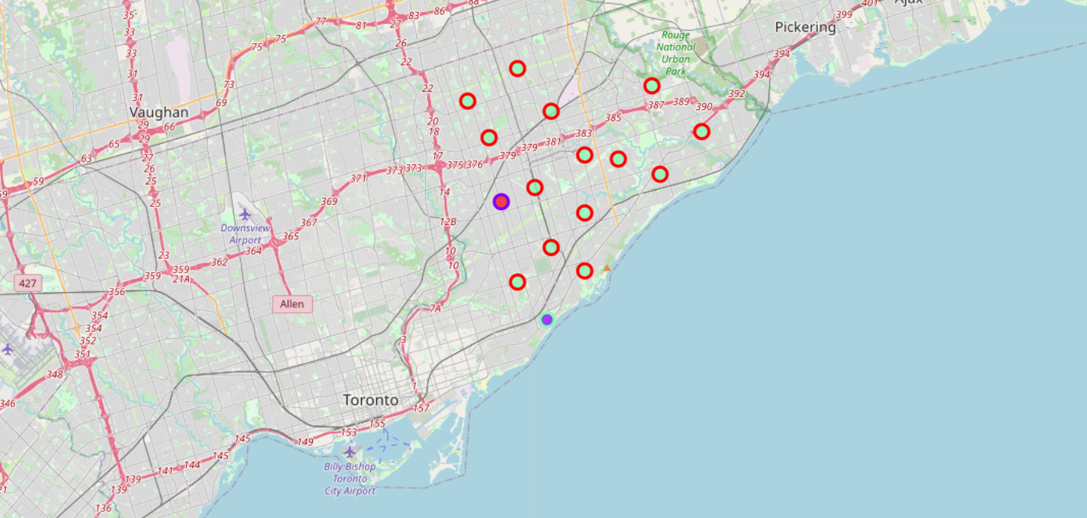
Map of Scarborough in Toronto Various Neighborhoods Clusters

Slide 5
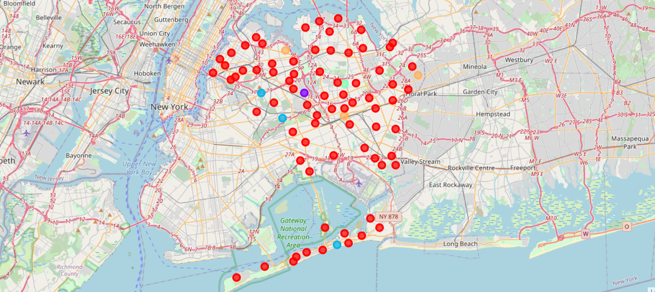
Map of Queens in New York City Various Neighborhoods Clusters

Slide 6
Findings
Scarborough neighborhood:
89 venues in 17 neighborhoods
80 distinct venues in 55 categories
Most common venues as Restaurants and Bakery
Queens neighborhood:
2113 venues in 81 neighborhoods
1742 distinct venues in 278 categories
Most common venues as Restaurants, Deli/Bodega, Pizza Place and Bakery

Slide 7
Conclusion
Based on the number and variety of venues, Queens is recommended over Scarborough as a choice to relocate. Queens offer more choices for restaurants, gymnasiums, grocery stores, and extracurricular activities for individuals and families.

Slide 8
Further Scope
Similar analysis can be done for any other city of the world to understand the neighborhoods
Any company in search of a best location to set up an office so that all the employees working can be benefitted settling around
Anyone looking to setup a business related to daily necessity like gymnasium, coffee shop, grocery store, etc.

